Slide 1

Biology for Engineers
21BE45
Dr. Prashantha Karunakar
Associate Professor
Department of Biotechnology
Dayananda Sagar College of Engineering
Bangalore
prashantha-bt@dayanandasagar.edu

Slide 2
Biology for Engineers
Nature-Bioinspired Materials and Mechanisms (Module-4)
Plant burrs (Velcro) - Overview
Scientists and engineers use what nature shows us to develop some of the most innovative technologies, such as a seahorse tail for a mechanical arm or kingfisher’s bill for a bullet train design.
One of the older biomimicry examples is Velcro
Velcro was inspired by burr seeds, which are covered in tiny hooks that easily attach to mammal fur.
Velcro has one side made up of tiny hooks, while the other side is covered in tiny loops.

Slide 3
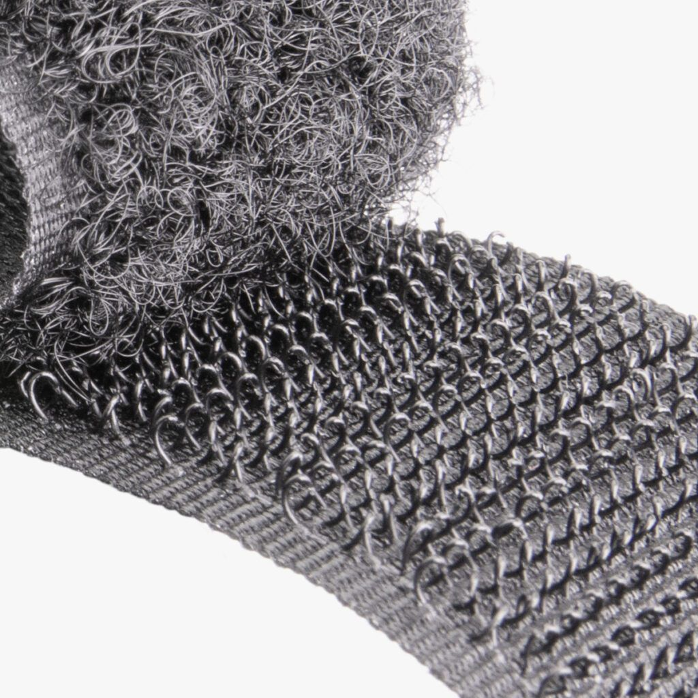
Velcro consisting of two strips of nylon fabric, one having tiny hooked threads and the other a coarse surface, that form a strong bond when pressed together. The fastener consisted of two components: a lineal fabric strip with tiny hooks that could ‘attach with another fabric strip with smaller loops, attaching temporarily, until pulled apart. Initially made of cotton, which proved impractical, the fastener was eventually constructed with nylon and polyester.

Slide 4
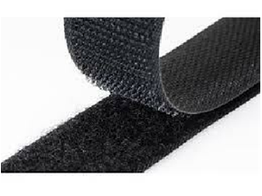
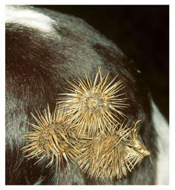
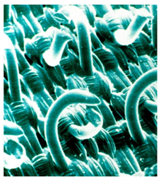
Biology for Engineers
Nature-Bioinspired Materials and Mechanisms (Module-4)
Plant burrs (Velcro) - Overview
Small hooks enable seed-bearing burr to cling to tiny loops in fabric.
Velcro fastening was invented in 1941 by Swiss engineer George de Mestral, who took the idea from the burrs that stuck to his dog's hair.
Under the microscope he noted the tiny hooks on the end of the burr's spines that caught anything with a loop - such as clothing, hair or animal fur.
The 2-part Velcro fastener system uses strips or patches of a hooked material opposite strips or patches of a loose - looped weave of nylon that holds the hooks

Slide 5
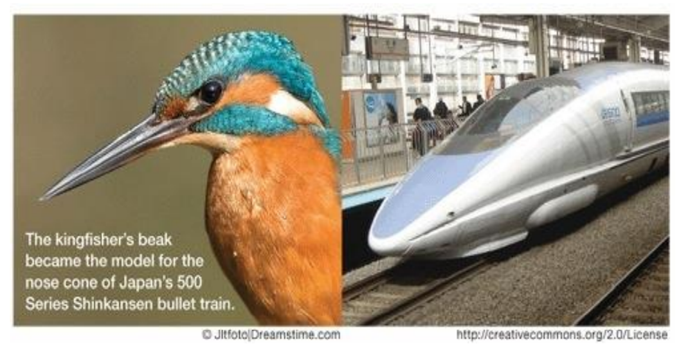
Biology for Engineers
Nature-Bioinspired Materials and Mechanisms (Module-4)
Bullet train design – Kingfisher beak
The fastest train in the world at speeds of up to 200 miles per hour, Japan’s Shinkansen Bullet Train was a marvel of modern technology.
But there was one major problem after its initial debut: noise. Each time the train emerged from the tunnel, it caused a change in air pressure that caused thunder-like sounds that were a nuisance from a quarter of a mile away.
The train’s chief engineer, a bird-watcher, had an idea: taking inspiration from the shape of a bird’s beak to make it more aerodynamic.
The resulting design was based on the narrow profile of a kingfisher’s beak, resulting in a quieter train that also consumes 15% less electricity and goes 10% faster than before.

Slide 6
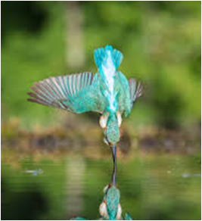
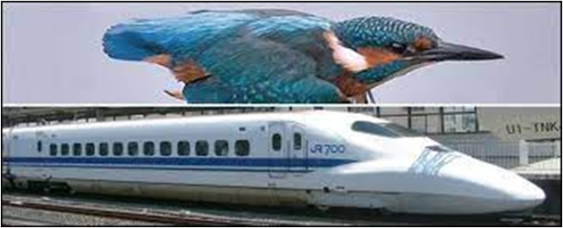



Biology for Engineers
Nature-Bioinspired Materials and Mechanisms (Module-4)
Bullet train design – Kingfisher beak
In 1990s, bullet trains created loud boom sound when moving through tunnels.
This was due to air cushion building in front of the train moving at high speeds.
An engineer had witnessed a kingfisher bird diving down through the air, going into the water and creating very little splash
•

Slide 7
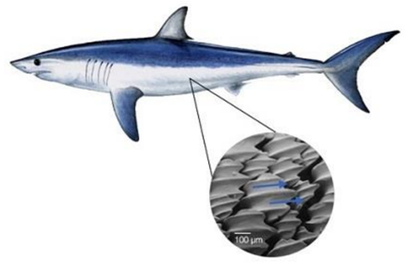
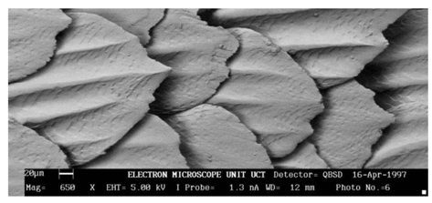

Biology for Engineers
Nature-Bioinspired Materials and Mechanisms (Module-4)
Sharkskin (Friction reducing swimsuits)
Shark skin is constructed of overlapping scales.
Nature through evolution, has ensured that water flows over the scales extremely efficiently, helping the shark to reach high speeds.
https://www.youtube.com/watch?v=YjeVRoDmXFs

Slide 8
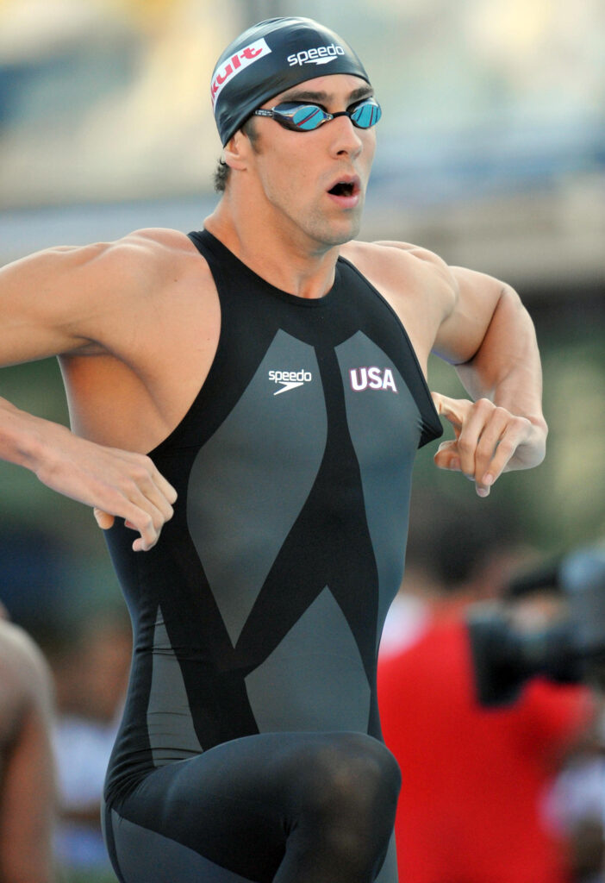
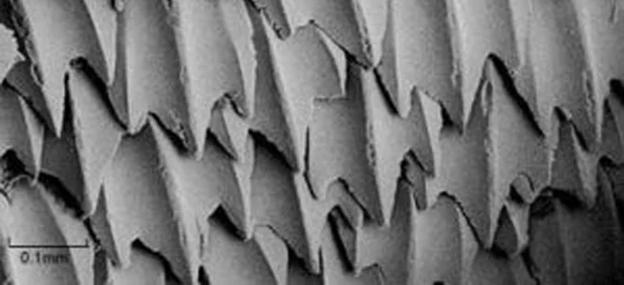
Biology for Engineers
Nature-Bioinspired Materials and Mechanisms (Module-4)
Sharkskin (Friction reducing swimsuits)

Slide 9
Bird flying (GPS and aircraft),
GPS
The Global Positioning System (GPS), is a satellite-based radio navigation that provides geolocation and time information to a GPS receiver anywhere on or near the Earth
GPS Components : Comprises of satellites( space segment ), ground stations ( control segments ) and receivers. ( user segments)
Satellites send signals. The ground stations uses the radar to track the satellites positions
The receiver is a device that might find in phone in car and continuously obtained signals from the satellites.

Slide 10
How does GPS work
The GPS space segment includes over 30 satellites in orbit operated
These satellites broadcast radio signals to control and monitoring stations on Earth
Relay directly to users requiring highly precise satellite positioning.
The receivers find out how far away they are from some other place
Once receiver calculates its distance from four or more satellites, it knows exactly where you are
They can usually determine where you are within a few yards of your actual location.
More high-tech receivers can figure out where you are to within a few inches!

Slide 11
Global Positioning System applications generally fall into 5 major categories:
Location – determining a position
Navigation – getting from one location to another
Tracking – monitoring object or personal movement
Mapping – creating maps of the world
Timing – bringing precise timing to the world

Slide 12
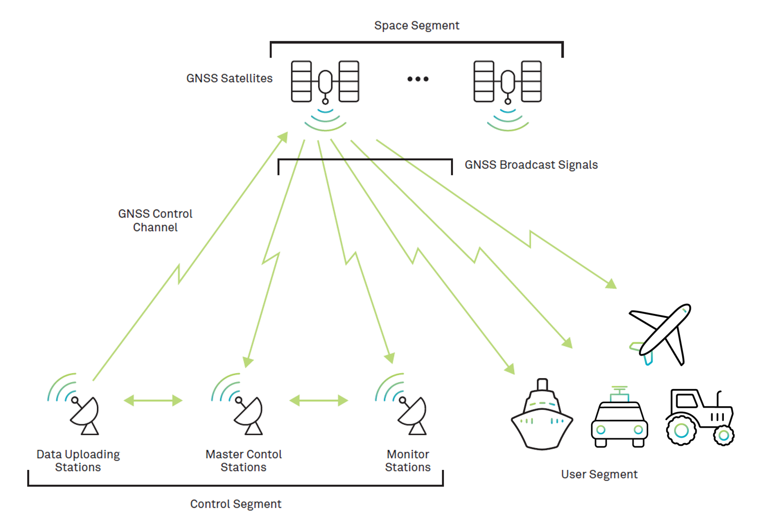
How GPS works

Slide 13
GPS and Bird Flight
Birds flight journey from one place to another place over a distance of few km to thousands. Birds brain works like GPS to find out the path of journey and distance
Birds flight journey uses earth magnetic field.
Bird can also visually detect magnetic fields, which provides them with a visual compass to guide their journey over long distances. Changes in the magnetic field are visible to birds.
Scientists have identified a protein in the eyes of some bird and is responsible for analyzing magnetic field .

Slide 14
Birds use magnetic field innovatively for navigating, just like a GPS, and also carry the capacity to turn it on and off.
Researchers from US and Canada discovered a region of the brain which is called cluster N that is used by birds to detect and process the magnetic field of the Earth.
Researchers identified 53 cells in the Pigeons brain that record detailed information on earths magnetic field , like a kind of internal GPS.
Experiment
Pigeons were held in a dark room and used 3D coil system to cancel out earth natural magnetic field

Slide 15
Replaced by tunable artificial magnetic field inside the room
During adjustment of elevation angles and magnitude of artificial magnetic field , they simultaneously recorded the activity of 53 neurons ( nerve cells) in the pigeons brain well in advance
They measured electric signals from each neurons as the magnetic field was changed and found that every neuron had its characteristics response to the magnetic field almost like 3D compass reading north –south directions.
Hence, birds magnetic navigation arises in cells that contain tiny metal in their nose or beaks.

Slide 16
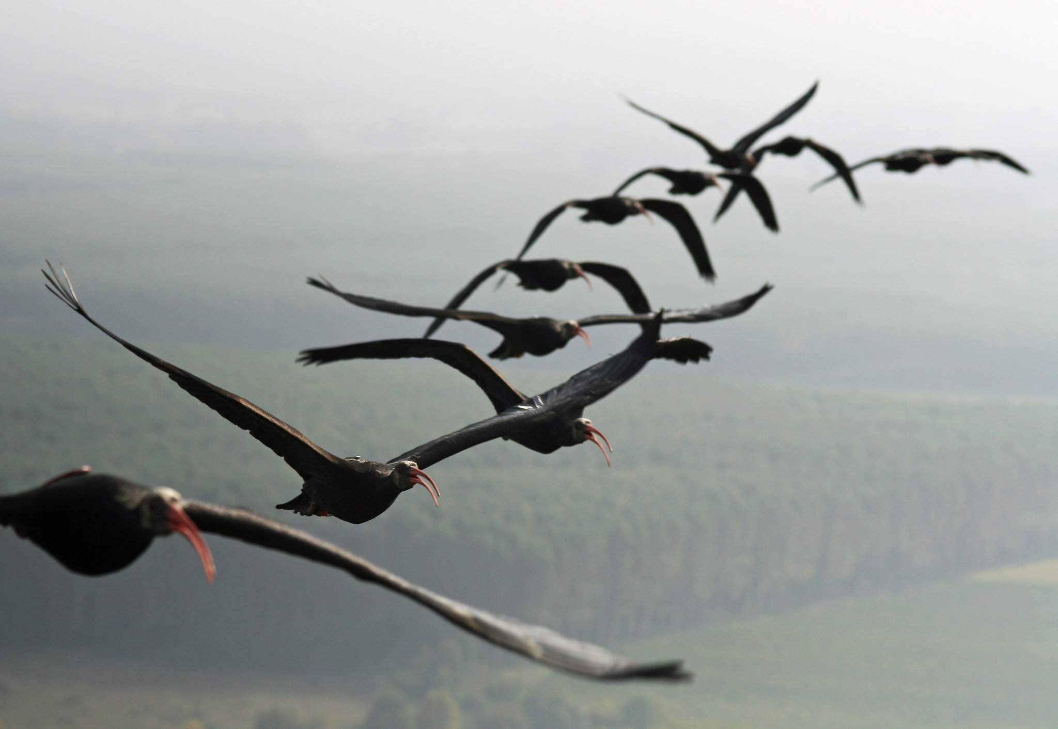
The birds like to use magnetically sensitive proteins called cryptochromes which are located in their retinas that enable their signalling and sensing functions, helping the birds in navigating the long distances they travel while migrating.
It shows that birds already had natural GPS before the invention of our GPS
In reality birds has several time edge over our GPS

Slide 17
Bird and Aircraft flying : Aerodynamics
Principles and Aerodynamics of flight in birds
Fundamentally, bird and aircraft flying are similar
Both bird and aircraft sustain on four aerodynamic of flight forces such as , lift, thrust, drag and weight
Birds flap their wings to generate lift and thrust, when they stop flapping and keep their wings stretched out, the wings actively produce lift
Lift is the component of aerodynamic forces perpendicular to the flow direction.
Flight in nature:
Unlike airplanes birds have either flapping or oscillating wings (hummingbird).
Birds have also the capabilities of adjusting the shape of the wing according to immediate flight situation

Slide 18
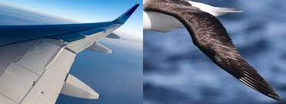
Aerodynamics of Birds wings:
Wings provides the main dynamic control for the bird. Helps in gliding and swapping
The lift and thrust is generated by wings, as opposed to aircraft that uses both wings and engines, control both speed and direction
The lift force is produced by the action of airflow on the wings
In order to generate thrust and lift during flight, birds change their wing shape
During flight, wings will be bent inwards during upstroke, and extended & straightened during downstroke. It minimizes drag and maximizes thrust and consequently ,energy efficiency

Slide 19
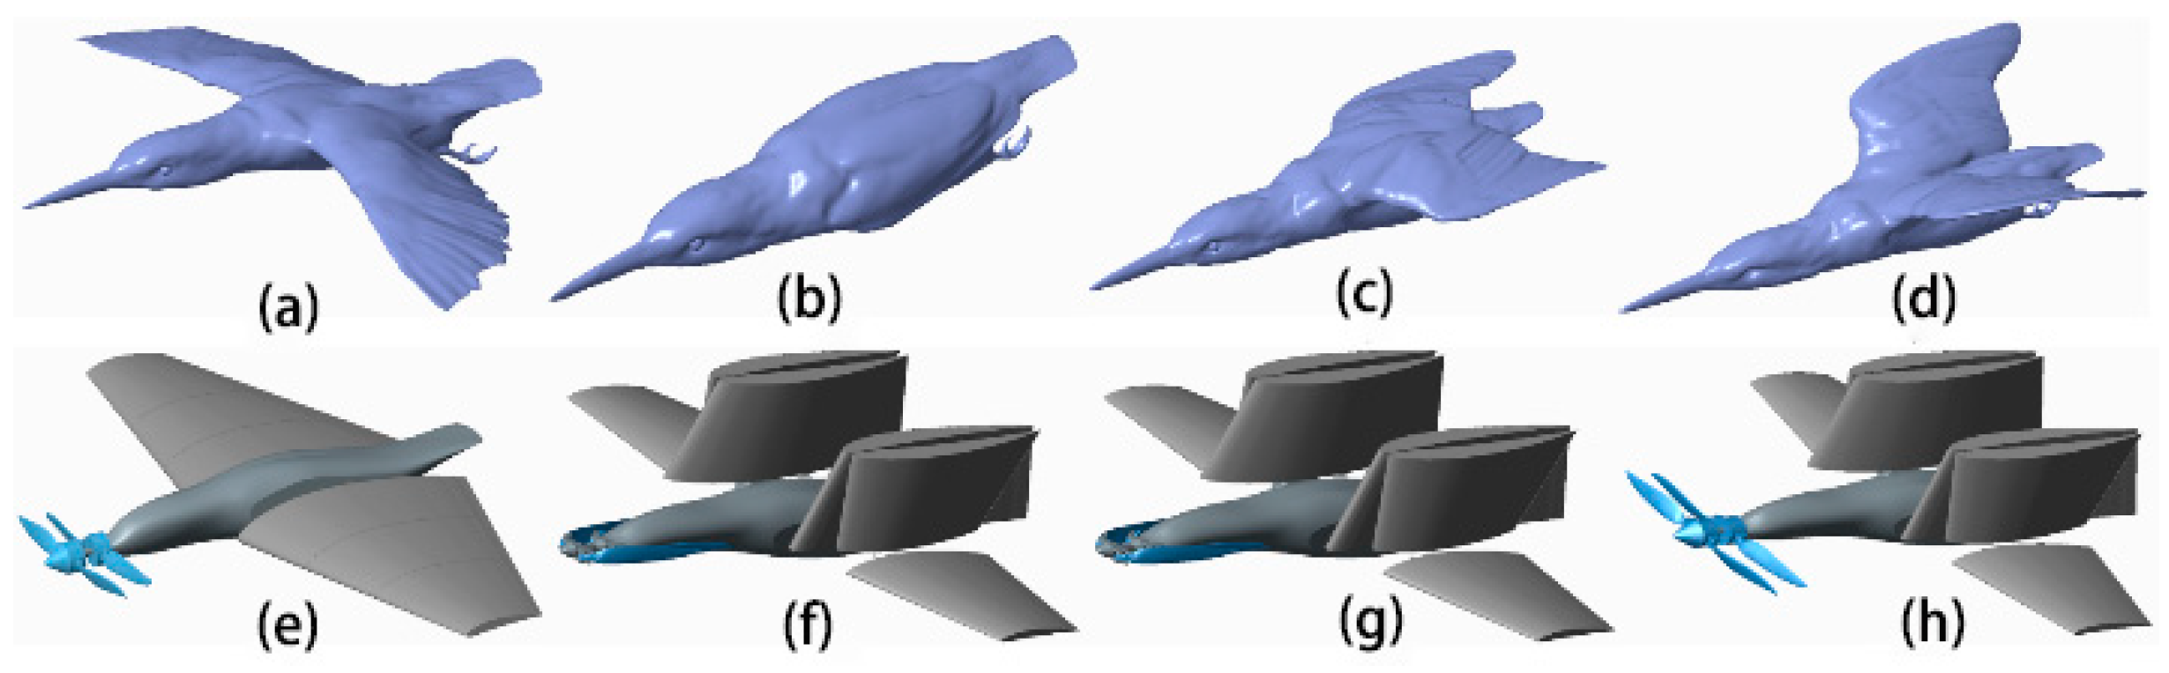
Gliding motion
In gliding, the wings are held out to the side of the body and do not flap.
Lift force is produced by the action of airflow on the wings. The lift force occurs because the air has a lower pressure just above the wings and higher pressure below.
Gliding always results in a bird moving downward through the air.
Weight
The weight of both bird and aircraft are very light . The light weight of birds is due to the nature of low density bones, which are fundamentally light for minimizing energy

Slide 20
Comparison between Bird and aircraft flight
Airplanes are man-made while birds are naturally born.
Birds flap their wings to fly while airplanes have engines, electrical wires, cables and require fuel to fly.
Airplanes need fuel to operate while birds require energy from food
Birds have feathers while the airplane does not.
Bird's wings provide lift and thrust while the airplane's wings have an airfoil shape that only provide lift.
Bird's can change their wingspan's shape while airplanes can twist and turn but not change their wingspan's shape.

Slide 21
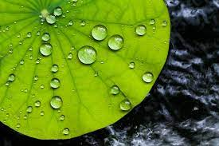
Lotus leaf effect (Super hydrophobic and self-cleaning surfaces),
The lotus effect refers to self-cleaning properties that are a result of ultrahydrophobicity as shown by the leaves of lotus flower.
Dirt particles are picked up by water droplets due to the micro- and nanoscopic architecture on the surface, which minimizes the droplet's adhesion to that surface. Hence lotus do not get wet when rains
This natural phenomena of lotus effect had inspired to develop ultrahydrophobic chemicals like perfluoroalkyl and perfluoropolyether

Slide 22
Mechanism of Lotus Effect
The high surface tension of water causes droplets to assume a nearly spherical shape,
Since a sphere has minimal surface area, and this shape therefore minimizes the solid-liquid surface energy.
On contact of liquid with a surface, adhesion forces result in wetting of the surface.
The cause of self-cleaning properties is the hydrophobic water-repellent double or two structure of the surface.
Basically, the leaves had two levels of structures for hydrophobicity
A microstructure level consisting of surface lumps and a nanostructure level formed by small hairs.
Both systems are constituted by a waxy coating, which together makes the surface of a lotus leaf repel water and does not get wet (superhydrophobic surfaces).

Slide 23
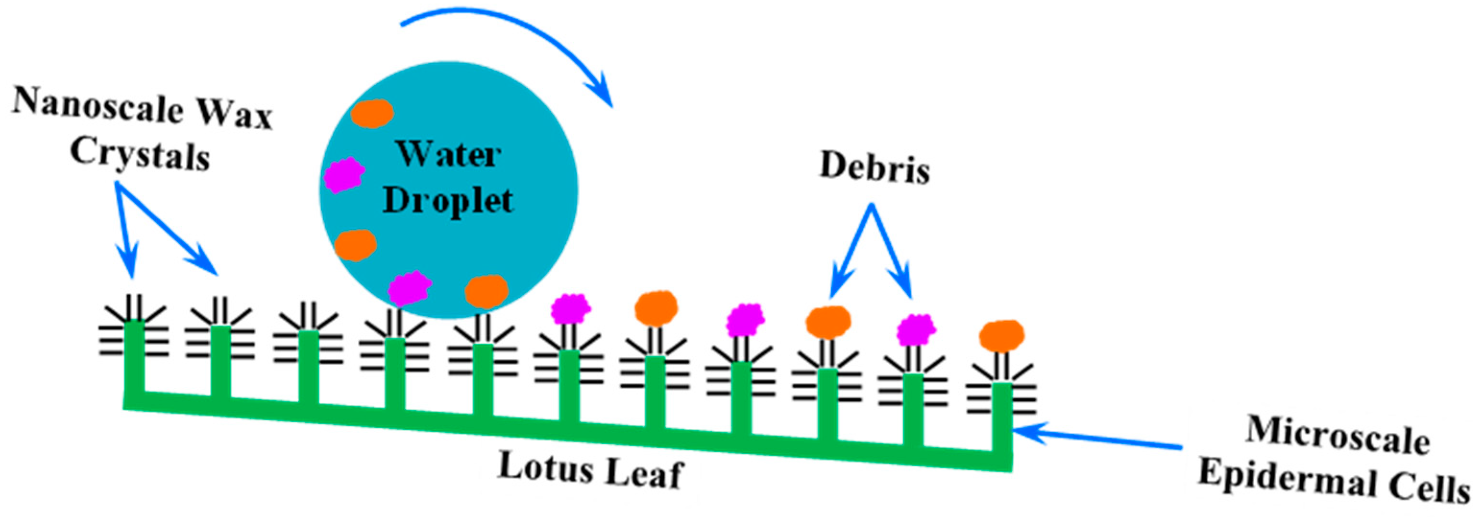
This enableis the contact area and the adhesion force between surface and droplet to be significantly reduced, resulting in a self-cleaning process
Hence, dirt particles with an extremely reduced contact area are picked up by water droplets and are thus easily cleaned off the surface.
The lower epidermis ( Inner layer of leaf) consists of convex cells covered with wax tubules and contains only few stomata. ( opening and closing structure of leaf)
The upper epidermis ( Outer layer of leaf) structure consisting of papillae with a dense coating of agglomerated wax tubules, which is the basis for the famous superhydrophobicity

Slide 24
Applications of Lotus Effect
Lotus a source of inspiration for innovative technological applications, including the building sector, with the creation of roofs and paints capable of self-cleaning.
The Lotus effect in the development of paints that prevent corrosion of metallic materials. Such paints have excellent physical and structural properties and the incomparable Lotus-Effect technology.
In this technology, the dirt slips away with the rain and the facade remains clean and dry for a long time.
Development of Perfect insulators to prevent damage to electrical or electronic equipment by accidental contact with water.
self-cleaning glasses installed in the sensors of traffic control
Developed stain-resistant textiles under the brand name nanosphere. Tests showed that clothes treated with NanoSphere technology allowed tomato sauce, coffee and red wine to be easily washed away even after a few washes.

